Slide 1
Community Structure InfoMap, Betweenness-based methods
MA 653: Network Science
Instructor: Ashok Singh Sairam
ashok@iitg.ac.in

Slide 2
Random walk
Consider a random walk on an undirected network
Sequence of nodes visited gives us some information
Simplest info: subset of edges in the network
Subtle info: Community ?
Many edges within community and few edges between communities, implies the random walk will linger within the community

Slide 3
Random walk: quantify information content
Quantify the information content of a random walk
Consider a possible division of the network
Assign each node a label
Give two labels to each community – entry and exit label
Encode the walk
record the label of the nodes visited
Construct the bit string
Concatenate the encoded symbols to bit strings
Notes:
Every time a random walk enters a community, record the entry label and every time it leaves record the exit label.

Slide 4
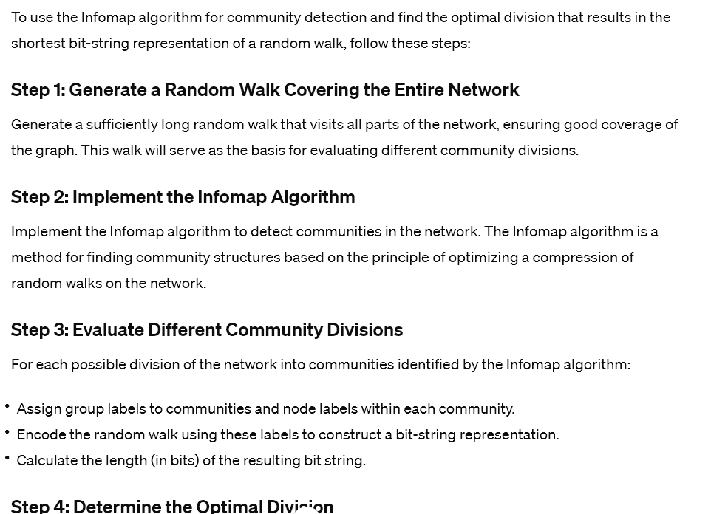
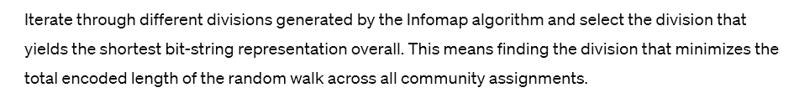
Infomap

Slide 5
InfoMap
Generate a random walk long enough to visit all parts of the network
For each possible division, find the set of group and node labels that give the shortest bit-string representation
Iterate through all the divisions and find the one that gives the overall shortest bit string
Although the approach will work in theory, it is tedious
Core of the calculation is finding the length of the shortest bit-string representation of the random walk for a particular community division
Notes:
An individual codeword for each node. There are regions of the network such that once the random walker enters a region, it tends to stay there for a long time, and movements between the regions are relatively rare. This allows us to combinatorially combine codewords into Huffman codes: we can use a prefix code for each region, and then use a unique codeword for each node within a module, but we can reuse these node level codewords for each module.
The same intuition can be gathered by looking at a street names; it would be crazy to have a unique street name for every street in the US, instead, we use states and towns, and then specify a street name, allowing us to reuse street names between towns (how many Main streets are there?).

Slide 6
Entropy
The entropy H(X) of a discrete information source X measures the average amount of information (in bits) needed to encode symbols from the source.
Mathematically, for a source X with discrete symbols x_1,x_2,…,x_n​ and probability mass function P(X=xi)=pi​, the entropy H(X) is defined as: H(X)=−∑_{i=1}^n p_ilog_⁡2p_i
Entropy quantifies the inherent uncertainty or randomness of the source, where higher entropy implies more uncertainty and lower redundancy in the symbol distribution.

Slide 7
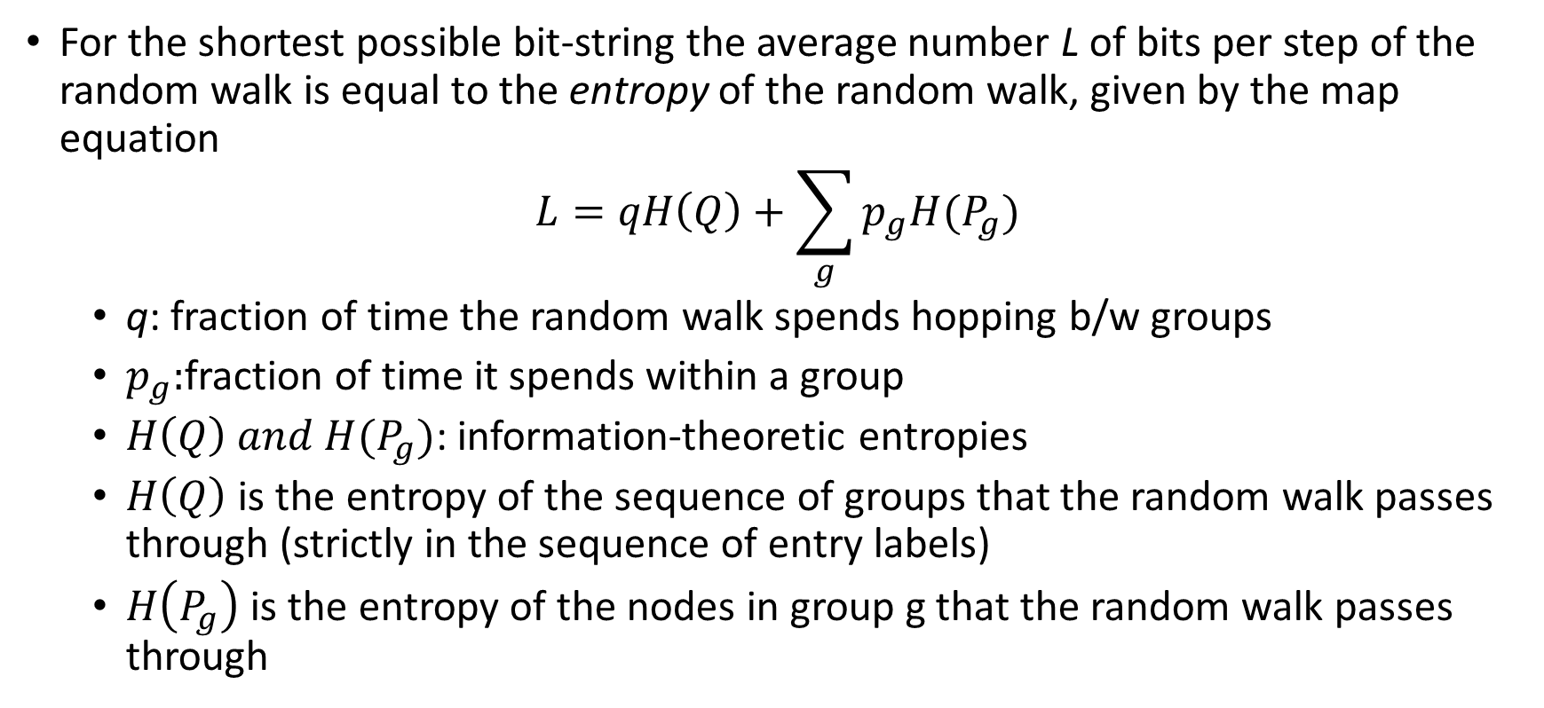
Shannon’s source coding theorem
For the shortest possible bit-string the average number L of bits per step of the random walk is equal to the entropy of the random walk, given by the map equation
$$L=qH\left(Q\right)+\sum_{g}{p_{g}H(P_{g})}$$
q: fraction of time the random walk spends hopping b/w groups
$p_{g}:$fraction of time it spends within a group
$H\left(Q\right) and H(P_{g})$: information-theoretic entropies
$H\left(Q\right)$ is the entropy of the sequence of groups that the random walk passes through (strictly in the sequence of entry labels)
$H\left(P_{g}\right)$ is the entropy of the nodes in group g that the random walk passes through
Notes:
The entropy of a random walk refers to the amount of randomness or uncertainty associated with the sequence of steps taken by a random walker in a stochastic process. In information theory, entropy is a measure of the average amount of information or surprise contained in a random variable.
The term "step" in the context of a random walk refers to the magnitude or direction of the movement taken at each time step in the sequence.

Slide 8
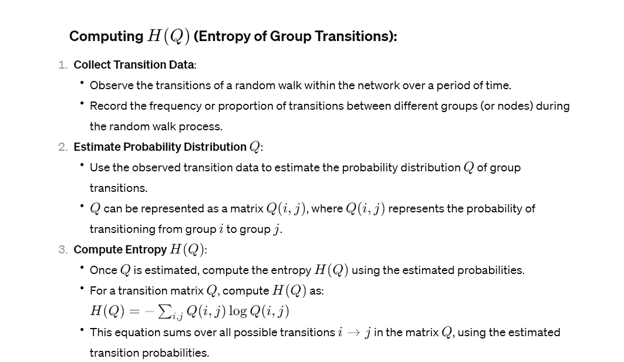

Slide 9

Shannon’s source coding theorem
The entropy of a sequence Q of objects is given by
$$H\left(Q\right)=−\sum_{i}{Q_{i}\log_{2}{Q_{i}}}$$
$Q_{i}$ fraction of times that object i appears in the sequence
Notes:
.

Slide 10
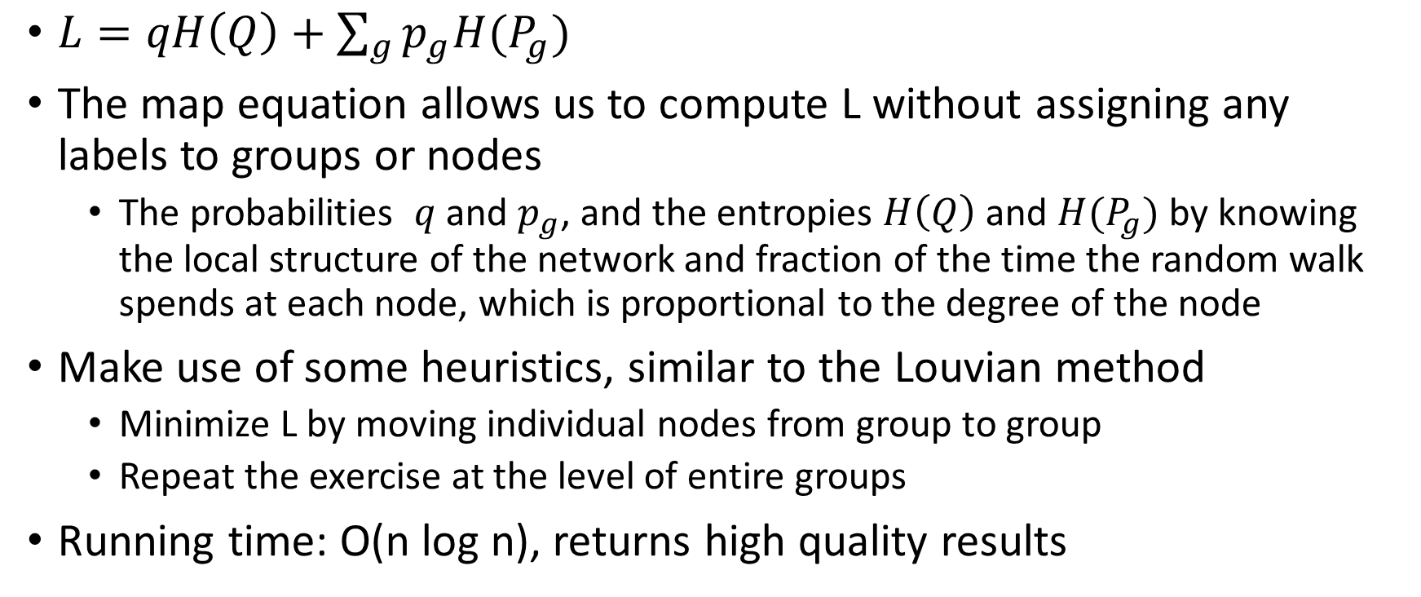
Significance of map equation
$L=qH\left(Q\right)+\sum_{g}{p_{g}H(P_{g})}$
The map equation allows us to compute L without assigning any labels to groups or nodes
The probabilities $q$ and $p_{g}$, and the entropies $H\left(Q\right)$ and $H(P_{g})$ by knowing the local structure of the network and fraction of the time the random walk spends at each node, which is proportional to the degree of the node
Make use of some heuristics, similar to the Louvian method
Minimize L by moving individual nodes from group to group
Repeat the exercise at the level of entire groups
Running time: O(n log n), returns high quality results

Slide 11
Other modularity maximization methods
Simulated annealing
Genetic algorithms
Greedy algorithms
We begin with every node belonging to a different community
At every step we combine the pair of groups whose amalgamation gives the biggest increase in modularity, or the smallest decrease if no choice gives an increase
Eventually all vertices are combined into a single group
We then trace back the states over which the network passed and we select the one with the highest value of modularity
Time complexity O(nlog²n)
The modularity achieved with greedy algorithms is slightly lower but it is much faster compared to the other two approaches

Slide 12
Betweenness-based method
While graph partitioning is a problem well-defined objective function (i.e., minimize cut set) the same does not hold true for community detection
Modularity maximization is only one of the possible ways to tackle the problem
Different objective functions can lead to different algorithms
One alternative to modularity maximization is to find edges that lie between communities
Once we remove them we will be left with just the isolated communities

Slide 13
Betweenness-based method
Edge betweenness is the number of geodesic paths that go through an edge
Edges that lie between communities are expected to have high betweenness because they will connect roughly all pairs of vertices between the communities
Time to calculate edge betweenness is O(n(m+n))
Notes:
BFS complexity (n+m).
The betweenness centrality of a node is the number of times the shortest paths in the network pass through a node. Similarly, we can define edge betweeness.

Slide 14
Computing edge betweenness
Consider the shortest path between every pair of nodes in the network
Except for nodes in different components
Calculate how many such paths go along each edge
Time to calculate edge betweenness is O(n(m+n))
Notes:
BFS from a node will find all the shortest path of the node. O(n+m)
Repeat for all nodes

Slide 15
Algorithm for community detection using betweenness
We calculate the betweenness of each edge
We find the edge with the highest score and remove it
We recalculate the betweenness of the remaining edges, since geodesic paths will have changed
Repeat the above process until we eventually have a completely disconnected network
Singleton vertices

Slide 16
The states of the network passes through the above procedure can be represented using a dendrogram (tree)
Leaves represent the final state (i.e., singleton nodes) while the top of the tree represents the starting state (i.e., a single community)
Horizontal cuts represent intermediate configurations
This algorithm gives a selection of different possible decompositions of the network
Coarse (i.e., top of the tree) vs fine divisions (i.e., bottom of the tree)
It is up to the user to decide which of the many divisions is useful

Slide 18
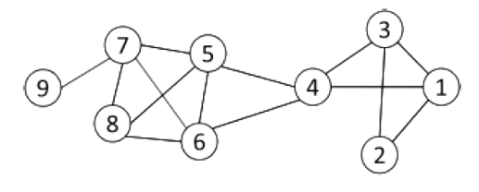
Example: Edge-betweeness

Slide 19
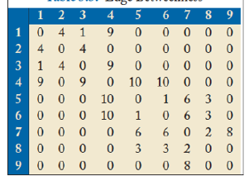
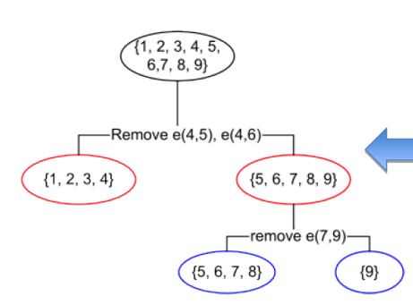

Slide 20
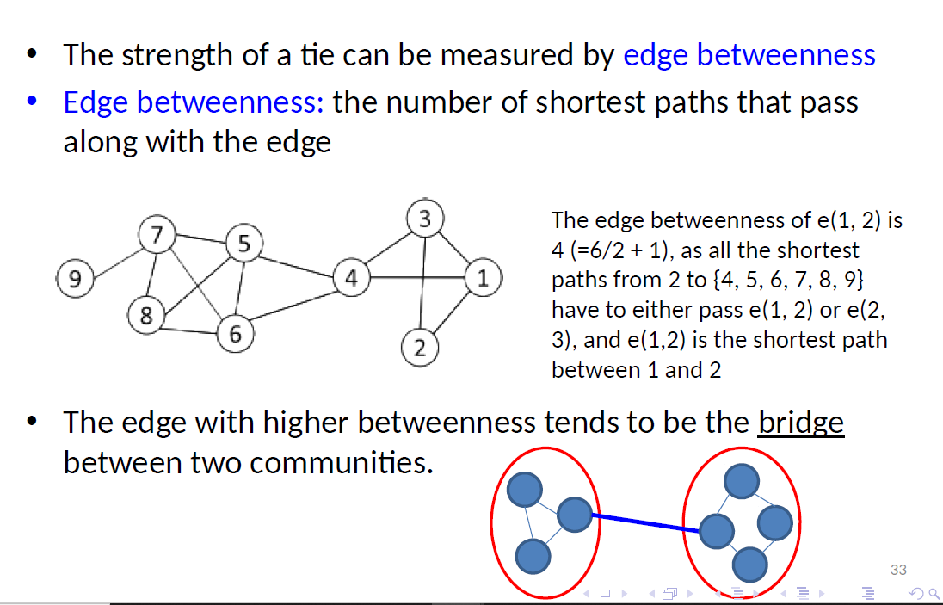

Slide 21
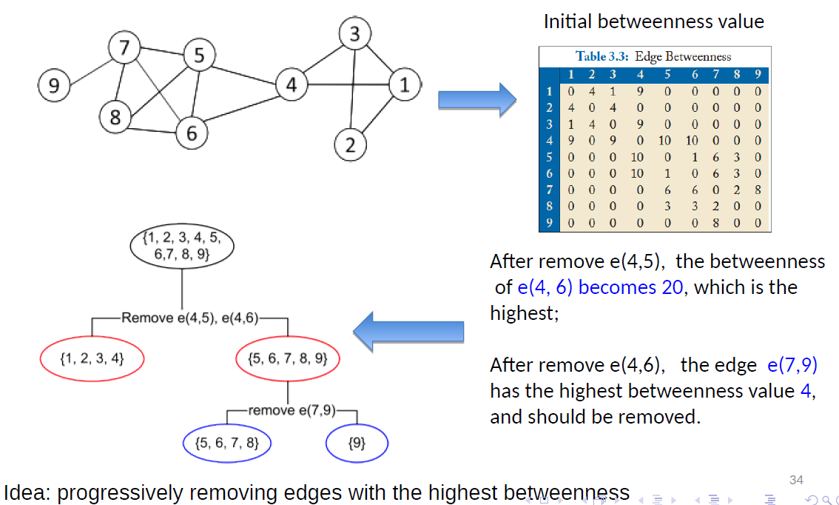

Slide 22
Betweenness-based method:Complexity
The above algorithm gives very good results
However, it is one of the slowest algorithms for community detection
Calculation of betweenness for all edges: O(n(m+n))
We must perform this calculation for each edge removed: O(mn(m+n)), to remove all edges
O(n³) in a sparse network
The ability to get an entire dendrogram rather than a single decomposition can be useful in many cases
Hierarchical decomposition

Slide 23
Betweenness-based method: variation
A variation of the above algorithm is based on the observation that an edge that connects two components that are poorly connected with each other is unlikely to participate to many short loops
Thus, one can identify the edges between communities by examining the number of short loops they participate in (rather than the betweenness)
Radicchi et al. found that examining for loop lengths 3 and 4 gave the best results
Notes:
intra edges form short loops; while inter edges are not in short loops.

Slide 24
Variation of betweenness based method
This approach is an order of magnitude faster compared to the betweenness-based approach
Computing short loops to which an edge belongs is a local operation
However, this approach works well when the network has a significant number of short loops to begin with
Social networks do have many short loops, however other types of networks (e.g., technological or biological) might not have this property

Slide 25
Hierarchical clustering
The betweenness-based community detection provided as an output a dendrogram
The dendrogram essentially decomposes the network into nested communities in a hierarchical fashion
There is an entire class of algorithms that are doing the same thing but operate using an agglomerative strategy rather than a divisive one
Hierarchical clustering algorithms

Slide 26
Hierarchical clustering: Basic Idea
The basic idea behind hierarchical clustering is to initially consider every vertex as one community
Then we define a metric of similarity between vertices, based on the network structure
Then we join the most similar vertices to the same group
We can use any metric of structural equivalence as the similarity metric
Cosine similarity, correlation coefficient between rows in the adjacent matrix, Euclidean distance between rows in the adjacent matrix etc.
Notes:
The fact that we can use many metrics is both good and bad.
Good → gives flexibility
Bad → there is no principle based on which we decide which metric to use (trial-and-error method)

Slide 27
Hierarchical clustering: group-wise similarity
Once we calculate the pairwise similarities, our goal is to group together the vertices that have the highest similarities
This can lead to conflicts
The first step is to join the singleton pairs with the highest similarity to a group of size two
Then we need to agglomerate groups with possibly more than one vertices
However, we have metrics for pairwise similarity not group similarity
How can we combine these vertex similarities to create similarities for the groups?
There are three ways of doing these: single-, complete-, and average-linkage clustering

Slide 28
Ways to create group similarity
Consider two groups of n₁ and n₂ vertices, respectively
There are n₁n₂ pairs of vertices among them (one node belongs to group 1 and the other to group 2)
Single-linkage clustering
The similarity between the groups is defined as the most similar of these n1n2 pairs of vertices pairwise similarities
Complete-linkage clustering
The similarity between the groups is defined as the smallest of the pairwise similarities
For example, if the similarity of the node pairs ranges from 1 to 100, the similarity of the two groups is 100 and 1 for single and complete-linkage, respectively

Slide 29
Ways to create group similarity
Average-linkage clustering
The similarity between the groups is defined as the mean of the pairwise similarities
Single-linkage clustering is very lenient, while complete-linkage clustering is more stringent
Average-linkage clustering is a more satisfactory definition and in between the two extremes, but it is rarely used in practice

Slide 30
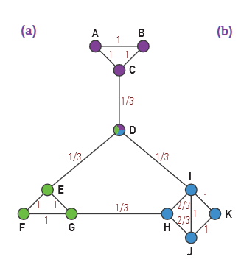

Slide 31
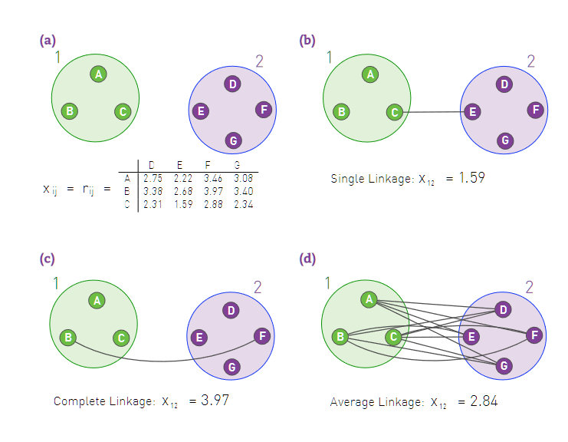
The table shows the distance r_{ij} between each node pair, acting as the similarity x_{ij}.

Slide 32
Hierarchical Clustering
The full hierarchical clustering method is:
Choose a similarity metric and evaluate it for all vertex pairs
Assign each vertex to a group of its own, consisting of just that one vertex
The initial similarities of the groups are just the similarities of the vertices
Find the pair of groups with the highest similarity and join them together into a single group
Calculate the similarity between the new composite group and all others using one of the three methods above (single-, complete- or average-linkage clustering)
Repeat from step 3 until all vertices have been joined to a single group

Slide 33
Hierarchical clustering: Time complexity
Time complexity O(n²logn) using a heap
With union/find and single-linkage clustering we can speed up to O(n²)
Hierarchical clustering does not always work well
It is able to find the cores of the groups, but tends to be less good at assigning peripheral vertices to appropriate groups
Peripheral nodes are left out of the agglomerative clustering until the very end
Hence, we have a set of tightly knit cores surrounded by a loose collection of single vertices or smaller groups
However, even this might be valuable information for the network structure

Slide 34
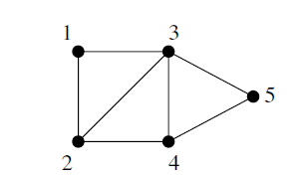
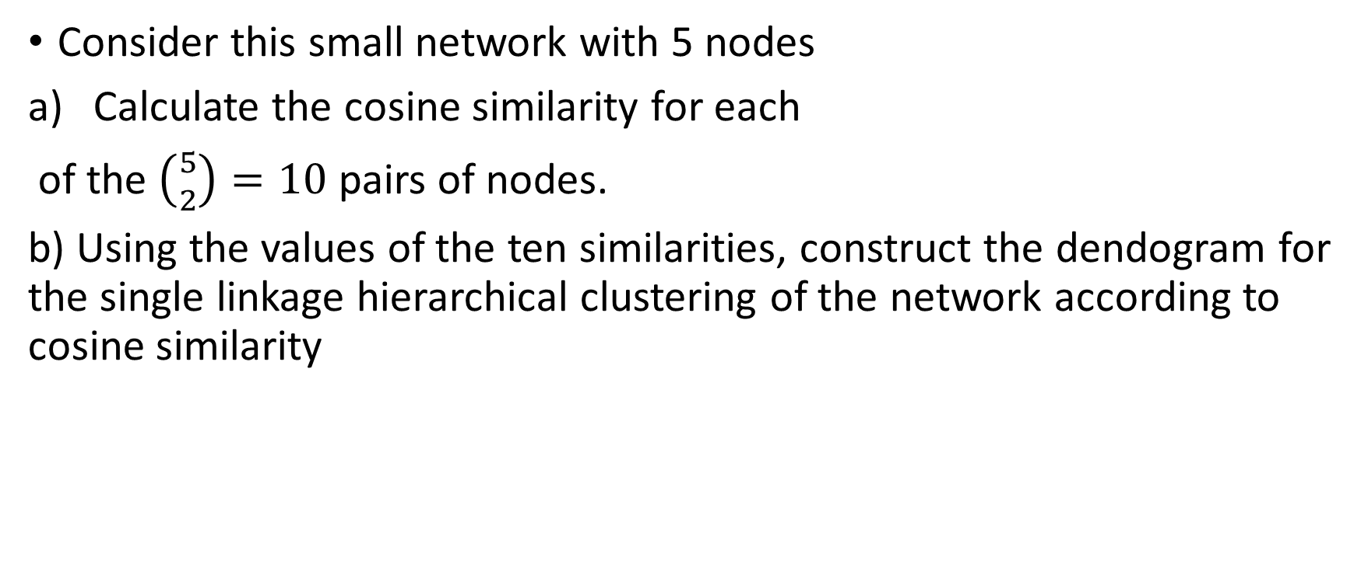
Ex:14.7
Consider this small network with 5 nodes
Calculate the cosine similarity for each
of the $\left({5 \atop 2}\right)=10$ pairs of nodes.
b) Using the values of the ten similarities, construct the dendogram for the single linkage hierarchical clustering of the network according to cosine similarity

Slide 35
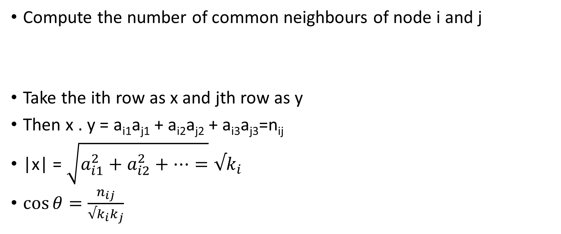

Review: Cosine Similarity
Compute the number of common neighbours of node i and j
Take the ith row as x and jth row as y
Then x . y = a_{i1}a_{j1} + a_{i2}a_{j2} + a_{i3}a_{j3}=n_{ij}
|x| = $\sqrt{a_{i1}^{2}+a_{i2}^{2}+…=}{√k}_{i}$
$\cos{θ=\frac{n_{ij}}{√k_{i}k_{j}}}$
$$\left[\begin{matrix}a_{i1} & a_{i2} & a_{i3} \\ a_{j1} & a_{j2} & a_{j3} \\ & & \end{matrix}\right]$$
x
y

Slide 36
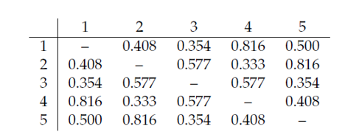

Slide 37

$A_{1i}=0 1 1 0 0$
$A_{2i}=1 0 1 1 0$
$A_{3i}=1 1 0 1 1$
$A_{4i}=0 1 1 0 1$
$A_{5i}=0 0 1 1 0$
$n_{12}=\frac{1}{√2√3}=$0.408 …..
$n_{14}=\frac{2}{√2√3}=0.816$

Slide 38
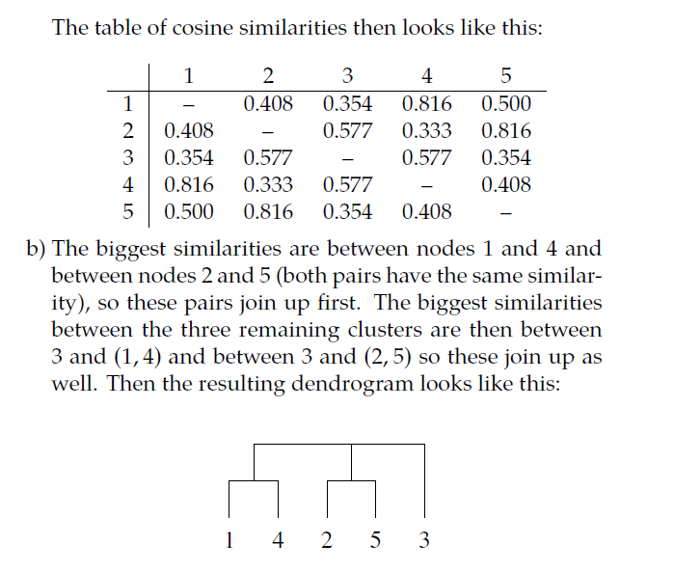
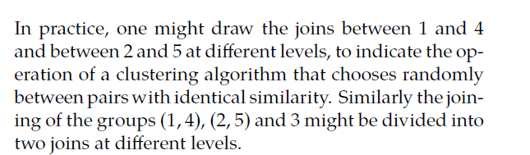

Slide 39
Comparison of Community Detection Algos.
No consensus about which one is the best
However, overall Modularity Maximization and Infomap are considered better
Return high quality results and are fast enough for large networks

